Slide 1
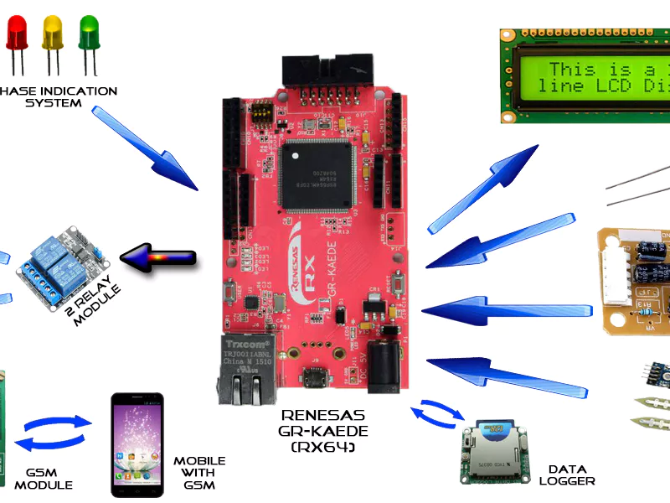
Lecture – 3
Weather Station

Slide 2

Overview
Weather Station
Temperature Sensor
Barometer Sensor
Light Sensor
UV Sensor
Dust Sensor
ICP Guideline

Slide 3

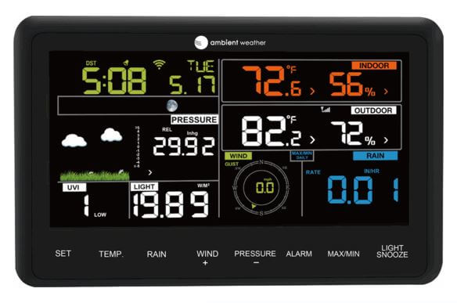
Weather Station
A weather station is a facility, either on land or sea, with instruments and equipment for measuring atmospheric conditions to provide information for weather forecasts and to study the weather and climate.
The measurements taken include temperature, atmospheric pressure, humidity, dust, light and ultra violet rays.

Slide 4
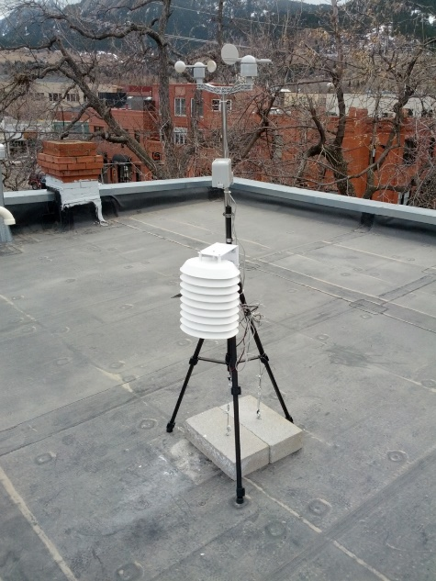
Continued ..
Manual observations are taken at least once daily, while automated measurements are taken at least once an hour or according to need.

Slide 5
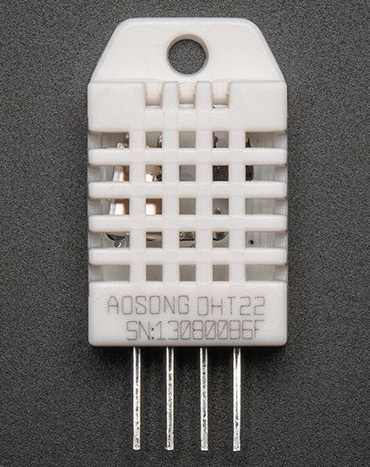
Temperature and Humidity Sensor
The DHT22 is a basic, low-cost digital temperature and humidity sensor.
It uses a capacitive humidity sensor and a thermistor to measure the surrounding air, and spits out a digital signal on the data pin (no analog input pins needed
The only real downside of this sensor is you can only get new data from it once every 2 seconds.
Simply connect the first pin on the left to 3-5V power, the second pin to your data input pin and the rightmost pin to ground.

Slide 6
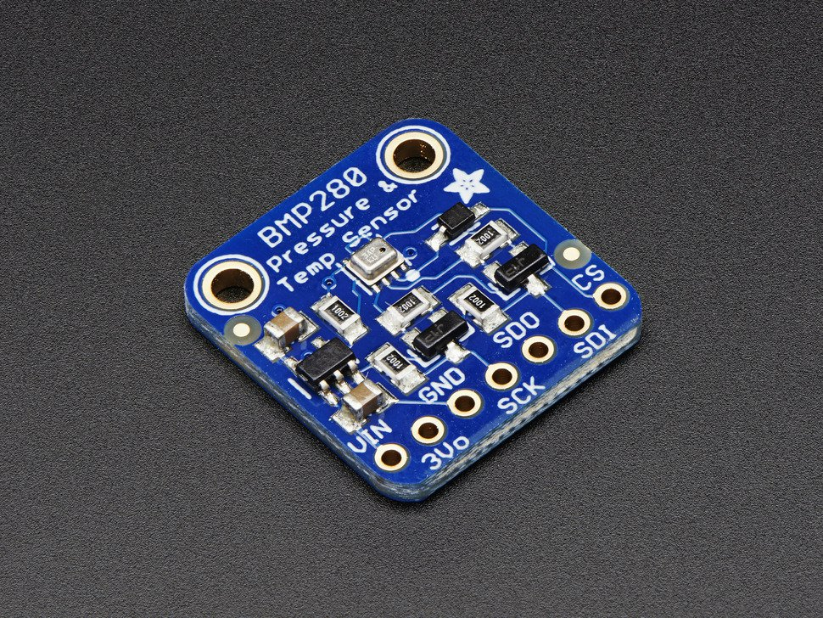
Barometer Sensor
This sensor is cable of displaying temperature, Altitude and Air pressure.
These sensors are even present in our mobile phones.
The reading can be sent to cloud

Slide 7
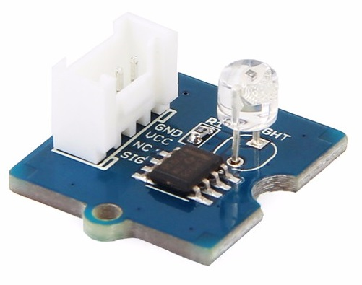
Light Sensor
Light sensor integrates a photo-resistor(light dependent resistor) to detect the intensity of light.
The resistance of photo-resistor decreases when the intensity of light increases.
The output signal is analog value, the brighter the light is, the larger the value.
This module can be used to build a light controlled switch i.e. switch off lights during day time and switch on lights during night time.

Slide 8
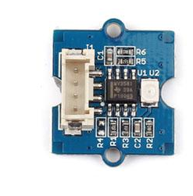
UV Sensor
UV Sensor is used for detecting the intensity of incident ultraviolet(UV) radiation.
The module outputs electrical signal which varies with the UV intensity
High stability, Good sensitivity, Low power consumption

Slide 9
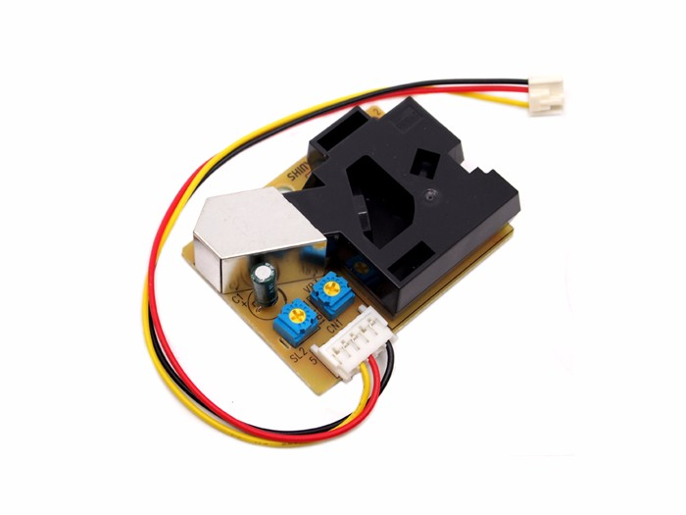
Dust Sensor
This Dust Sensor gives a good indication of the air quality in an environment by measuring the dust concentration.
The Particulate Matter level (PM level) in the air is measured by counting the Low Pulse Occupancy time (LPO time) in given time unit.
LPO time is proportional to PM concentration. This sensor can provide reliable data for air purifier systems

Slide 10
Today’s ICP
Assemble Temperature, Barometer, Light, UV and Dust sensor separately
Display results in IDE monitor
Connect LCD with each component and display results
Connect WIFI with each module
Transmit the results to ThingSpeak Server
Visualize the results in Mobile
Record video for each component
Explain each component to the Instructors

